Slide 1
Cell
Regulation of Ferroptotic Cancer Cell Death by GPX4
Wan Seok Yang, Rohitha SriRamaratnam, Matthew E. Welsch, Kenichi Shimada, Rachid Skouta, Vasanthi S. Viswanathan, Jaime H. Cheah, Paul A. Clemons, Alykhan F. Shamji, Clary B. Clish, Lewis M. Brown, Albert W. Girotti, Virginia W. Cornish, Stuart L. Schreiber, and Brent R. Stockwell.
Cell. 2014 Jan
Loqman Samani
Notes:
Welcome everyone to my presentation. Today, I will discuss the article “Regulation of Ferroptotic Cancer Cell Death by GPX4,” published in 2014.

Slide 2
Introduction to Ferroptosis
Programmed cell death
Iron-dependent
Dixon SJ et al., 2012 "Ferroptosis: an iron-dependent form of nonapoptotic cell death"
Reactive Oxygen Species (ROS)
Phospholipids with polyunsaturated fatty acids (PUFA-PLs)
Accumulation of lipid peroxides
Different from apoptosis, necrosis, and autophagy
Notes:
Now, let's start with a brief introduction to ferroptosis, Which we already familiar with. Ferroptosis is a type of programmed cell death. It is iron-dependent and was first described by Dixon and his colleagues in 2012.
Unlike other forms of cell death like apoptosis, necrosis, and autophagy, ferroptosis relies on iron and reactive oxygen species, or ROS.
This process involves the accumulation of lipid peroxides, which are harmful molecules formed when phospholipids containing polyunsaturated fatty acids, or PUFA-PLs, get oxidized. These lipid peroxides cause damage to cell membranes, leading to cell death.

Slide 3
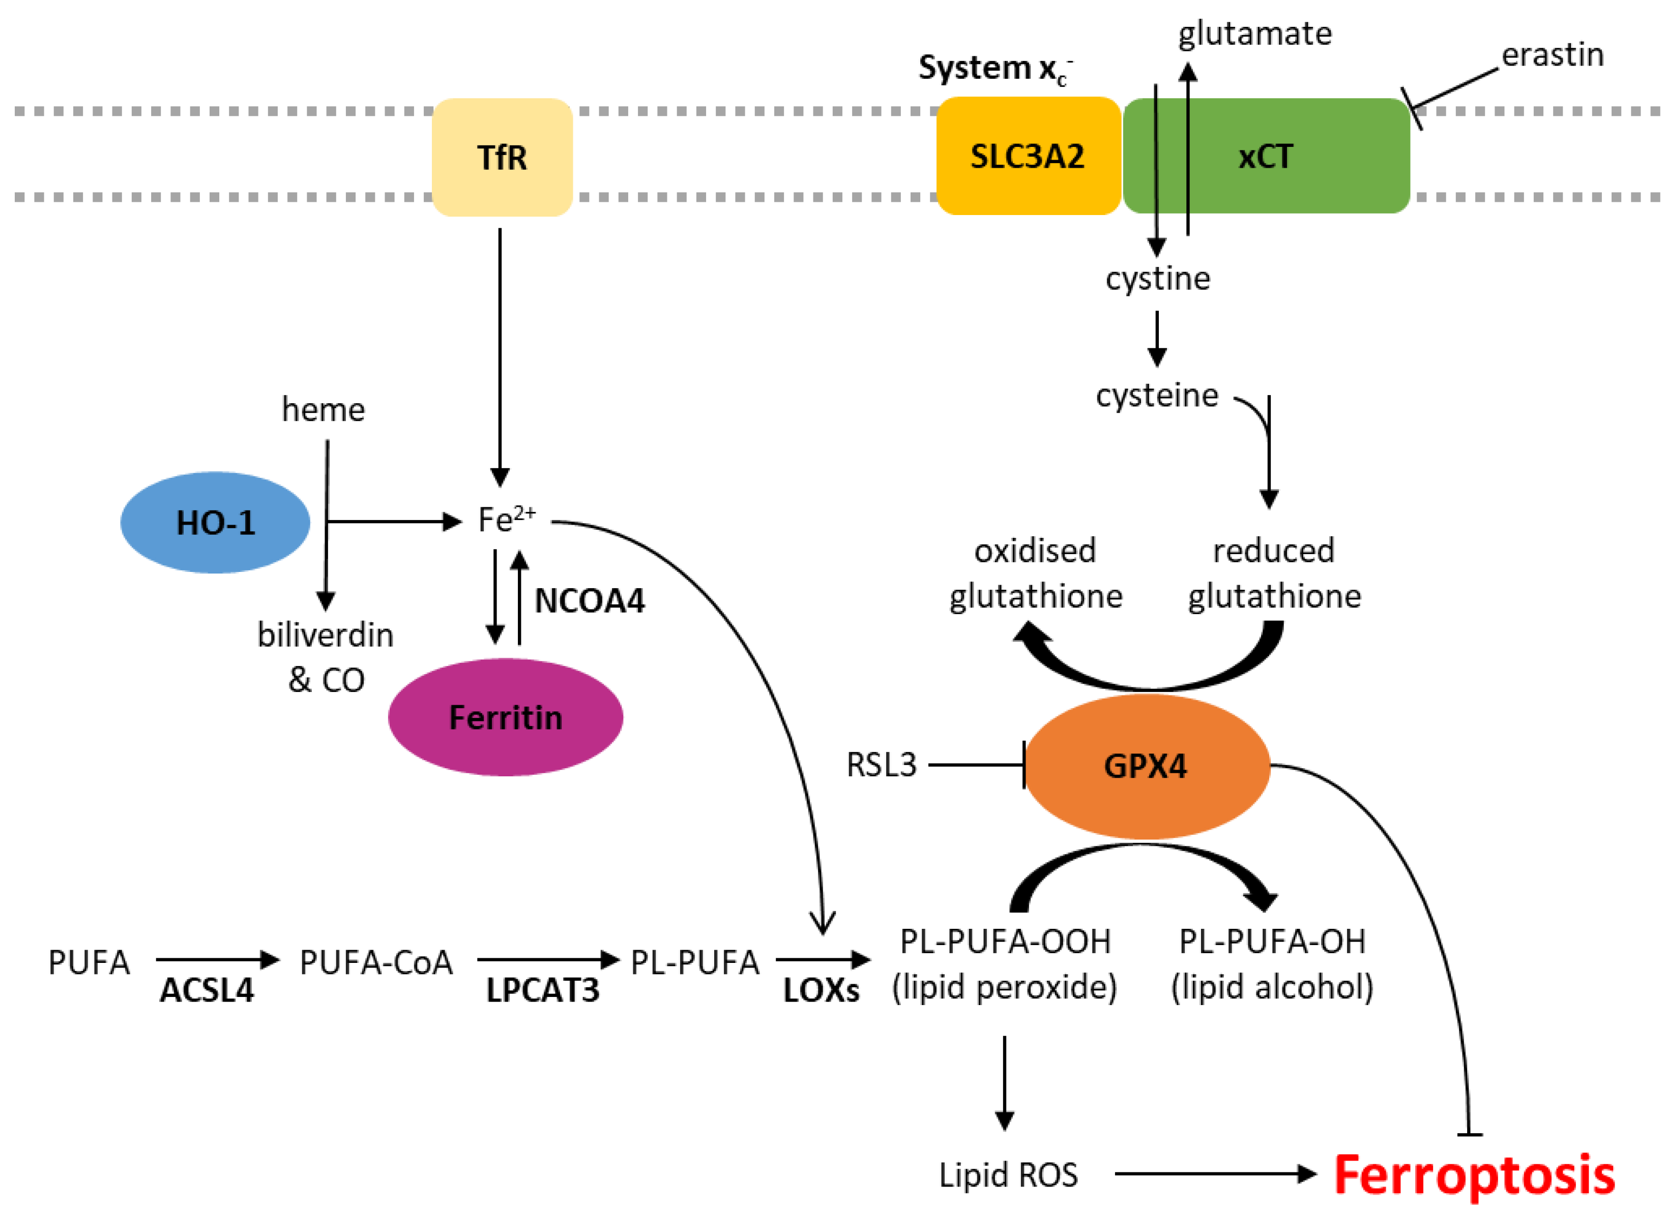
Aims of the study
xCT: Cystine/glutamate transporter
GPX4: Glutathione Peroxidase 4
FINs: Ferroptosis Inducing Agents
Figure1: Biochemical pathways involved in the regulation of ferroptosis. R. Mynott et al., 2023
Understand regulation of ferroptosis
Indirect regulation by Class 1 FINs (e.g., Erastin)
Direct regulation by Class 2 FINs (e.g., RSL3)
Notes:
The aim of this study, which I'll be presenting, is to explore how ferroptosis is regulated, particularly through the direct and indirect regulation of GPX4, which stands for glutethiane peroxides 4.
Figure 1 on the slide illustrates the main biochemical pathways involved in ferroptosis. It highlights two key mechanisms:
The first one: Indirect regulation by class 1 FINs (short for Ferroptosis inducing agents) like Erastin, which inhibit cytine/glutamate transporter(xCT), leading to the depletion of glutathione and subsequent inhibition of GPX4.
The second one: Direct regulation by class 2 FINs like RSL3, which directly inhibit GPX4.
In this presentation, we'll focus on Erastin and RSL3 as examples of molecules that regulate ferroptosis through GPX4.

Slide 4
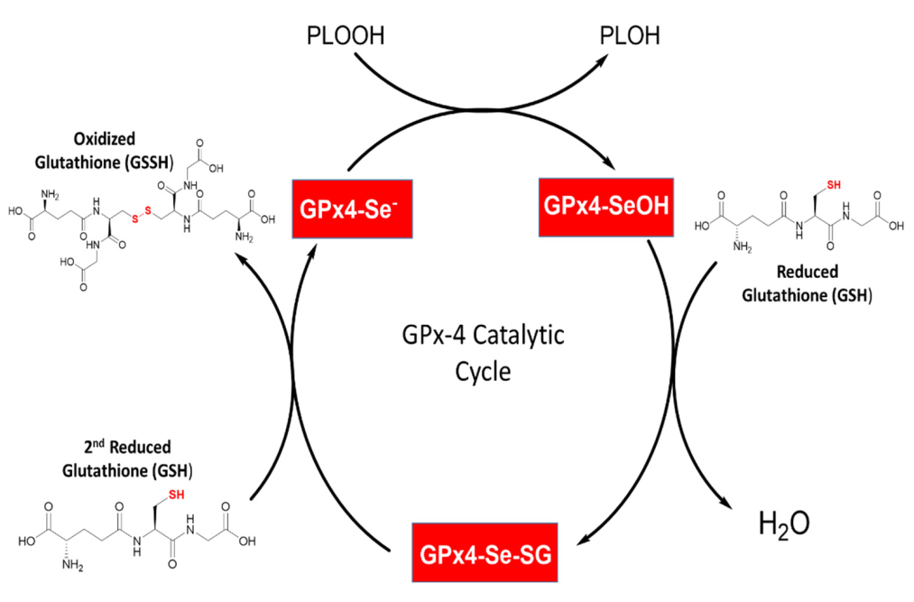
Glutathione Peroxidase 4 (GPX4)
GPX Family: GPX1 - GPX8
Key regulator of ferroptosis
Reduces complex hydroperoxides (PLOOH) to alcohols (PLOH)
Uses reduced Glutathione (GSH) as reducing agent
Figure2: GPX4 catalytic cycle representation. Weaver, K.; Skouta, R. Biomedicines 2022
Notes:
Now, let's delve into Glutathione Peroxidase 4, or GPX4, which is a crucial player in ferroptosis.
GPX4 belongs to the Glutathione Peroxidase family, which consists of eight enzymes: GPX1 to GPX8. This family is a central component of the cellular antioxidant defense system.
Among them, GPX4 is the key regulator of ferroptosis. It functions by reducing complex hydroperoxides into their respective alcohols. This process is essential for preventing the accumulation of harmful lipid peroxides.
If we look at Figure 2, we can see how this enzyme reduces hydroperoxides to the corresponding alcohols using glutathione as a reducing agent.

Slide 5
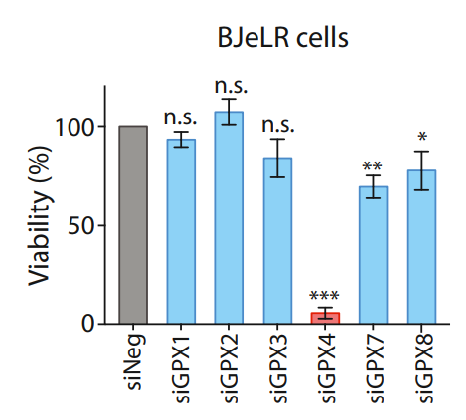
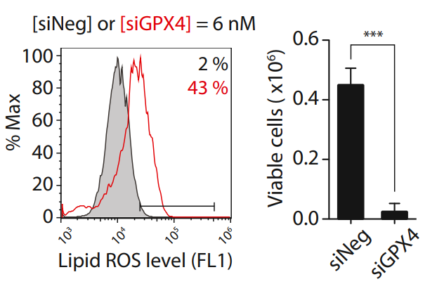
Prominent role of GPX4 in Ferroptosis
In BJeLR cells, six GPX isoforms are expressed
GPX4 knockdown is the most lethal to BJeLR cells
Increased Lipid ROS Levels in Cells with GPX4 Knockdown
Figure3: Other GPX isoforms are not relevant to ferroptotic cell death
Figure4: cells transfected with siRNAs targeting GPX4 showed increased lipid ROS level
Notes:
As the first part of this study, we will analyze experimental results that demonstrate the role of GPX4 in ferroptosis.
In a cell line known as BJeLR, six of the eight GPX family members, namely GPX1, 2, 3, 4, 7, and 8, were expressed. Then using siRNA, each isoform was individually knocked down to evaluate their effects on cell death by ferroptosis. As illustrated in Figure 3, several GPX family members (like GPX7, GPX8) significantly induce ferroptosis. However, the impact of GPX4 knockdown on cell viability is much greater than that of the other proteins, highlighting the critical role of GPX4 in regulating ferroptosis.
And if we look at Figure 4, we observe a significant increase in lipid ROS levels in cells with GPX4 knockdown. Given GPX4's crucial role as an enzyme in reducing ROS, it is logical that knocking down this enzyme leads to increased cell death through ferroptosis.

Slide 6
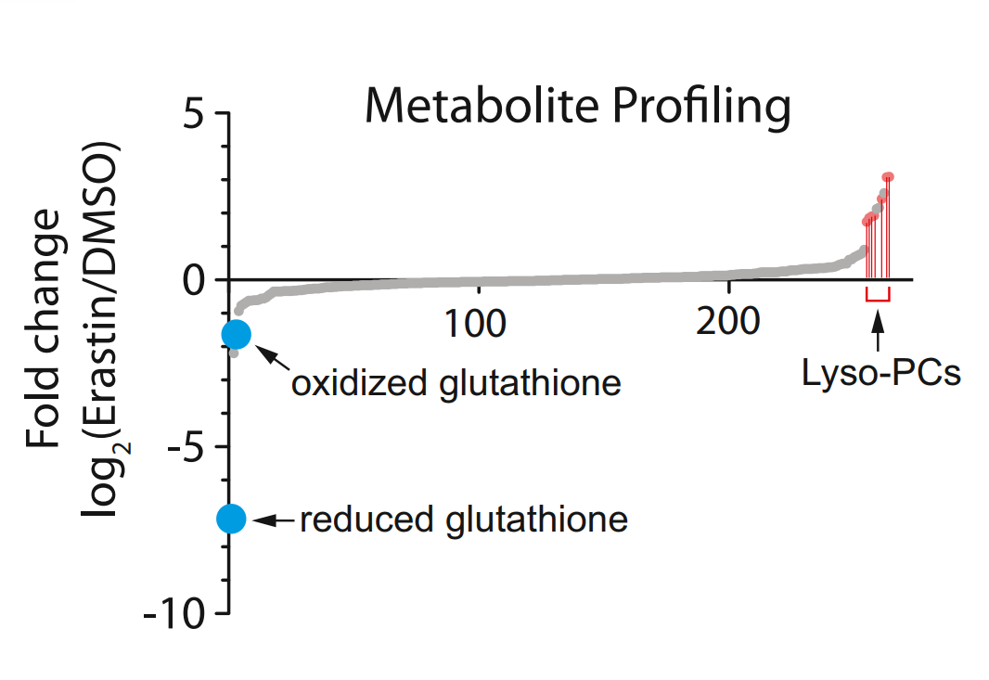
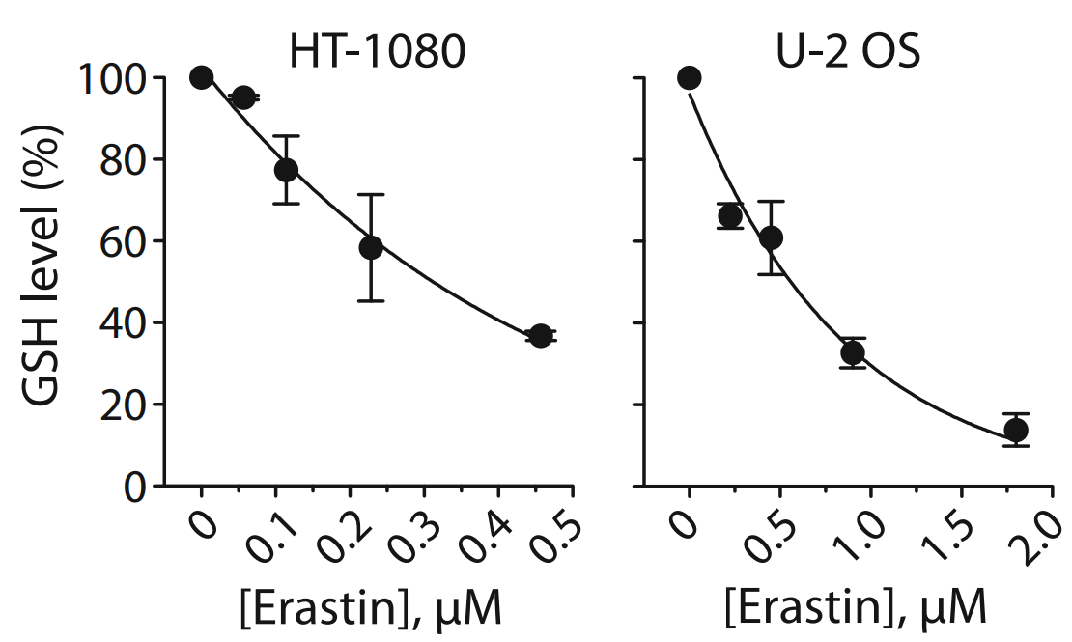
Erastin Depletes Glutathione to Trigger Selective Ferroptosis
Investigate global metabolic changes induced by erastin
Treated HT-1080 fibrosarcoma cells with erastin
Extraction and analysis of polar and lipid metabolites
LC-MS/MS analysis to quantify metabolites
Figure5: changes in metabolites upon Erastin treatment
LC-MS/MS: Liquid chromatography–mass spectrometry
Lyso-PCs: Lysophosphatidyl cholines
Figure6: Dose-dependent depletion of GSH by Erastin in HT-1080 cells and U-2 OS cell
Notes:
Now it is time to discuse the role and mechanism of erastin as an example of indirect regulator of the GPX4 enzyme. In this part of the study, the researchers investigated the effect of Erastin on cellular metabolism. To understand the metabolic changes induced by erastin, they treated HT-1080 fibrosarcoma cells with erastin. After treatment, they extracted polar and lipid metabolites from the cells and analyzed these extracts using liquid chromatography- mass spectrometry, or LC-MS/MS. This analysis allowed them to quantify the extracted metabolites.
As shown in Figure 5, erastin treatment resulted in significant changes in some metabolite levels. Notably, there was a reduction in both reduced (GSH) and oxidized glutathione (GSSG). This reduction is represented by the values below zero on the Y-axis, which indicates a decrease in their cellular levels. Additionally, there was a significant increase in lysophosphatidyl cholines (lyso-PCs), which may reflect the generation of lipid reactive oxygen species (ROS) during erastin-induced ferroptosis.
In Figure 6, a dose-dependent reduction of GSH by erastin in different cell lines (two different cell lines HT-1080 and U-2 OS) is shown, here we see a negative correlation between GSH levels and erastin concentration.
These findings highlight how erastin-induced glutathione reduction leads to the accumulation of ROS, which can trigger ferroptosis.

Slide 7
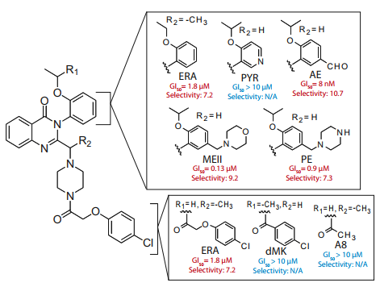
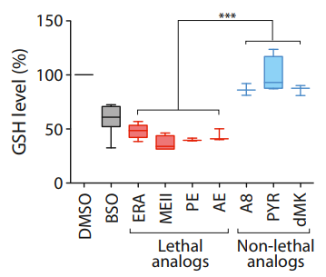
GSH-Reduction Activity and Lethality of Erastin Analogs
Figure7: Structure and activity of Erastin (ERA) analogs
Figure8: GSH depletion by Erastin analogs
Notes:
In this part of the study, the researchers aimed to determine the association between GSH-reduction activity and the lethality of Erastin. To explore this, they synthesized six different Erastin analogs, which are shown in Figure 7 on the left-hand side. These analogs were tested for their lethality and their GSH-reducing activity.
The results of these tests are plotted in Figure 8 on the right-hand side of the screen. Here, we observe that the lethal analogs of Erastin, namely ERA, MEII and PE, exhibit higher GSH-depleting activity compared to the non-lethal analogs.
These findings suggest that the GSH-depleting activity is essential for Erastin and its analogs lethality.

Slide 8
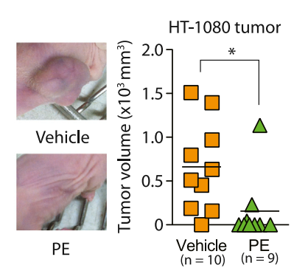
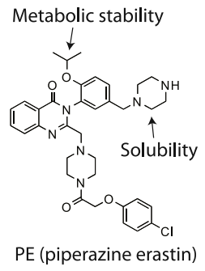
Ferroptosis Inducer (Erastin) Inhibit Tumor Growth in a Mouse Model
Treated mice with Piperazine Erastin (PE)
Significant delay in tumor growth in the PE-treated
Figure9: PE showed efficacy in preventing HT-1080 tumor formation
Notes:
Here we are going to analyse the results of using Erastin as a treatment at the species level. The researchers employed a mouse model and treated it with an analog of Erastin named "Piperazine Erastin" (PE). They chose this analog because it has a higher metabolic stability and also a greater water solubility compared to Erastin. You can see the chemical structure of this molecule on the left side of the screen.
The researchers injected the mice with HT-1080 cancer cells and subsequently treated them with PE for a relatively short period of time. They then monitored tumor growth in the treated mice and compared it with control mice that received only the vehicle.
As illustrated in Figure 9 on the right-hand side, PE treatment significantly prevented tumor growth in the PE-treated mice compared to the vehicle-treated mice.
Vehicle: The primary function of a vehicle is to deliver the active substance (PE in this context) in a consistent manner that allows for accurate dosing and administration. It serves as a control against which the effects of the active substance can be measured.

Slide 9
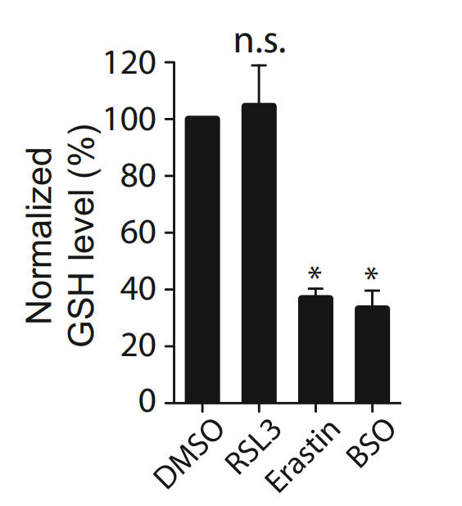
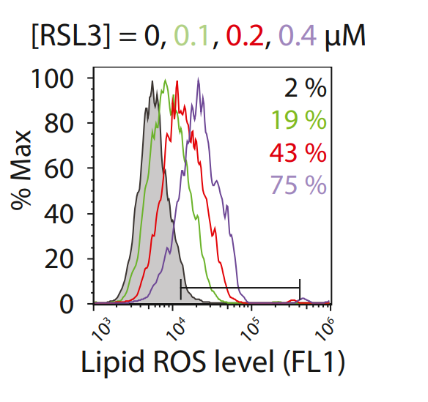
RSL3 Binds to and Inactivates GPX4
.
GSH remained unaffected by a lethal RSL3 concentration(2 µM)
Increasing RSL3 level leads to increasing in lipid ROS level
Figure10: RSL3 does not deplete GSH.
BSO: Buthionine sulfoximine, inhibits the synthesis of GSH by inhibiting gamma-glutamylcysteine synthetase.
DMSO: Dimethyl sulfoxide, control.
Figure11: RSL3 treatment increased lipid ROS level
Notes:
Here we are going to analyse the action-mechanism of RSL3 as an direct regulator of GPX4, as studied in another segment of this study. The researchers discovered that cellular GSH levels remain unaffected when cells are treated with a lethal concentration of RSL3. This contrasts with Erastin, which significantly reduces GSH levels as shown in Figure 10.
This suggests that RSL3 doesn't rely on GSH depletion to work.
So They looked at how different amounts of RSL3 affected lipid ROS levels.
As can be seen in Figure 11, the ROS levels in the cells also increased with the RSL3 dose. This shows that RSL3 causes oxidative stress by increasing lipid peroxidation without the need to reduce GSH levels.
BSO: Buthionine sulfoximine. a specific inhibitor of gamma-glutamylcysteine synthetase, which is the rate-limiting enzyme in the synthesis of glutathione (GSH), a crucial antioxidant molecule in cells

Slide 10
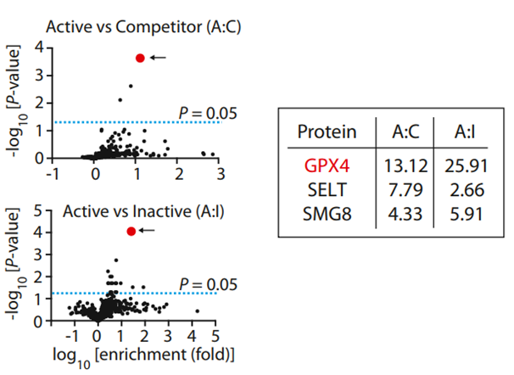
RSL3 Binds to and Inactivates GPX4
.
GSH remained unaffected by a lethal RSL3 concentration(2 µM)
Increasing RSL3 level leads to increasing in lipid ROS level
GPX4 is the top candidate protein target for RSL3
Figure12: Affinity-based chemoproteomics identified GPX4 as the most likely binding protein for RSL3
Notes:
To understand how RSL3 reduces cellular ROS levels without depleting GSH, researchers used affinity-based chemoproteomics. In Figure 12, which shows the results of this experiment, GPX4 is highlighted in red as the top protein targeted by RSL3. This suggests that RSL3 directly interacts with GPX4, potentially explaining how it influences cellular ROS levels independently of GSH.
Affinity-based chemoproteomics: is a scientific method used to identify and study interactions between small molecules (like drugs or compounds) and proteins within cells. It involves using chemical probes that are designed to bind specifically to target proteins of interest. By analyzing these interactions, researchers can identify potential target proteins for a given compound and understand its mechanism of action at the molecular level. In the context of RSL3 and GPX4, affinity-based chemoproteomics was employed to identify GPX4 as a primary target of RSL3, revealing how RSL3 affects cellular processes related to oxidative stress and cell death.
Active Probe Treatment: This treatment allows the active form of RSL3 to interact and bind specifically to its target proteins within the cells.
Inactive Probe Treatment: This serves as a control to distinguish non-specific binding or background interactions that might occur with the fluorescein tag itself or with the inactive form of RSL3.
Competitor Treatment: This treatment is designed to compete with the active probe for binding sites on target proteins within the cells.

Slide 11
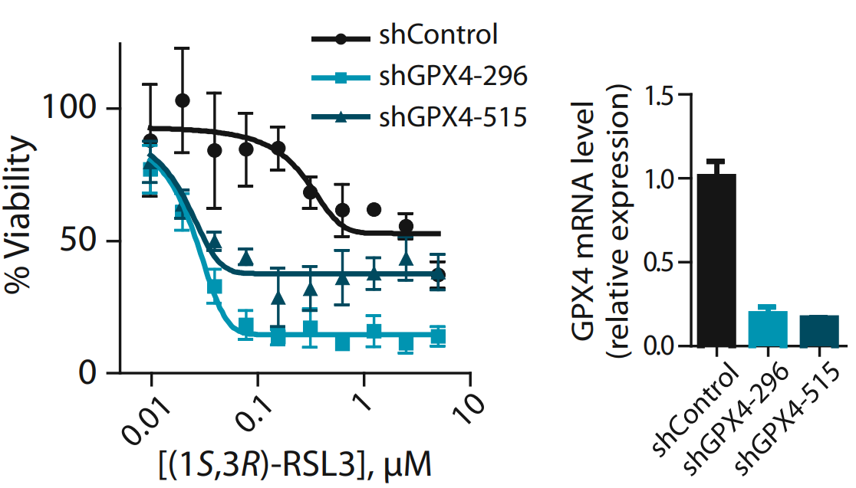
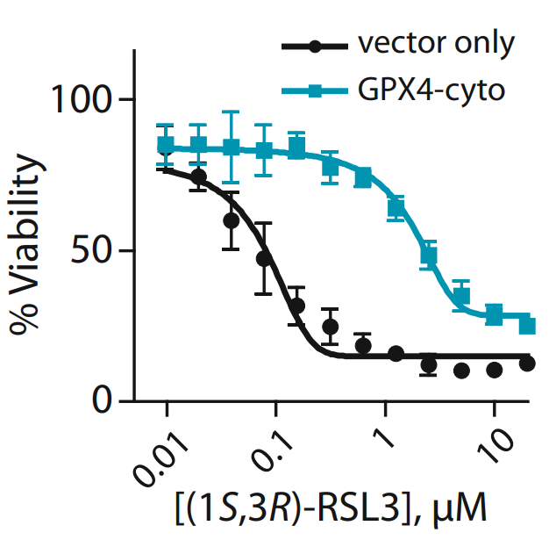
GPX4 expression level affects RSL3 lethality
Reducing the GPX4 level leads to sensitize cells to RSL3
overexpression of GPX4 caused strong resistance to RSL3
Figure13: Knockdown of GPX4 using shRNAs hypersensitive to RSL3 lethality
Figure14: Overexpression of GPX4 resistant to RSL3 lethality
Notes:
In this section of the study, the effect of GPX4 expression levels on the lethality of RSL3 was investigated. First, GPX4 mRNA was knocked down using shRNA. As shown in Figure 13, the bar graph illustrates the GPX4 relative expression levels for two different shRNAs compared to the control sample. We can see that the GPX4 mRNA level in the knockdown samples is reduced to about one-fourth of the control.
The scatter plot on the left side of this figure shows the cell viability of these knockdown cell lines treated with different concentrations of RSL3. As the RSL3 concentration increases, the viability of the cells decreases, indicating that reducing GPX4 levels sensitizes the cells to RSL3.
In the second illustration on the bottom right side(figure 14), GPX4 is overexpressed. This scatter plot demonstrates the cell viability of these overexpressed cell lines treated with various concentrations of RSL3. Overexpression of GPX4 results in increased resistance to RSL3, as shown by higher cell viability even at higher concentrations of RSL3.
When we compare these two conditions, we can clearly see how GPX4 expression levels affect cell sensitivity to RSL3 treatment. Reducing GPX4 levels increases sensitivity, while overexpressing it provides resistance to RSL3 treatment.

Slide 12
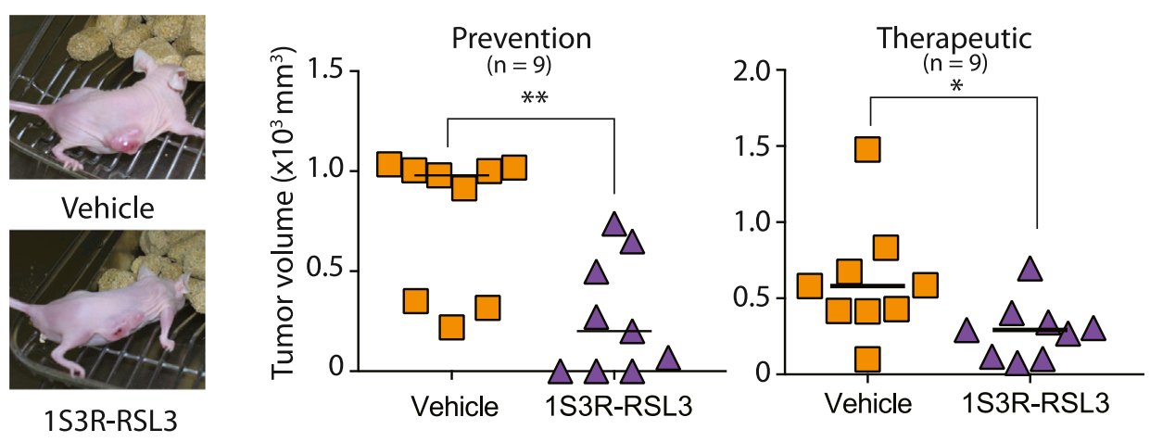
Ferroptosis Inducer (RSL3) Inhibit Tumor Growth in a Mouse Model
Treated mice with RSL3
Significant tumor growth prevention
Significant tumor shrinkage in preexisting tumors
Figure15: RSL3 inhibited tumor formation and tumor progression
Notes:
As we've seen in the species-level experiment with Erastin, let's now shift our focus to the results with RSL3.
In this part of the study, they used the same mouse model in two different experiments. In the first experiment, mice were injected with human cancer cells and then treated with RSL3 one day later (which is the same presedure as in erastin experiment).
On the left side of Figure 13, we can compare tumor growth between an RSL3-treated mouse and a control mouse. The middle diagram shows how, at the population level, the tumors in RSL3-treated mice were smaller compared to those in control mice.
In the second experiment (which is a new presidure), mice were treated with RSL3 one week after they received human cancer cell injections, meaning the tumors were already established. As shown in the right side diagram of the figure, there is a significant shrinkage in the tumors of mice treated with RSL3.
R and S: Configuration

Slide 13
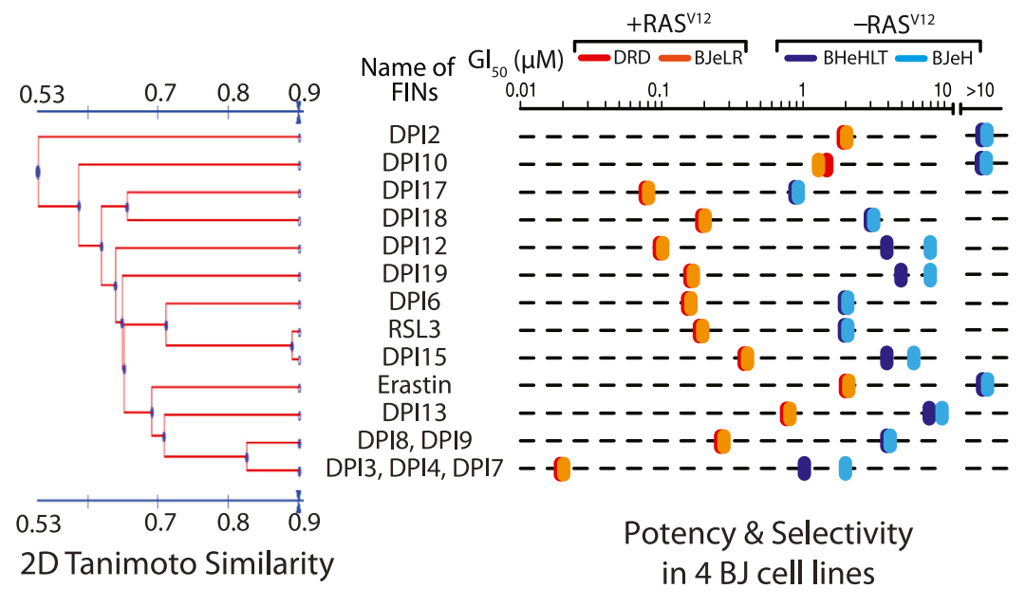
Discovery of Additional FINs and Their Potency in BJ Cell Lines
Figure 16: Discovery of additional FINs based on selective lethality in the four BJ cell lines
Tanimoto coefficient
0 = no similarity, 1 = identical structure
GI50s of DPI17
DRD & BJeLR ~ 0.1 µM
BHeHLT & BJeH ~ 1 µM
Notes:
As the last part of my presentation, we analyze the discovery of additional ferroptosis-inducing compounds, or FINs, based on their selective lethality in BJ cell lines.
If we look at the Figure 16, the left panel of this figure shows a dendrogram representing the structural similarity among 16 discovered FIN compounds, using the 2D Tanimoto Similarity measure. Here higher values indicate greater structural similarity. (by the way, to choose these 16 molecules they tested over a million different compounds, which obviously is a huge amount of work)
anyway
The right panel displays the potency and selectivity of these compounds in four BJ-derived cell lines(DRD, BJeLR, BHeHLT and BJeH). The potency is represented by GI50 values, which indicate the concentration needed to inhibit cell growth by 50%. Lower GI50 values mean higher potency. Each colored dot represents a different cell line, with the position indicating the GI50 value for each compound.
From the diagram, we can see that some compounds, like DPI6 and RSL3 show high potency in specific cell lines, such as BJeLR, indicated by low GI50 values. This highlights the differential sensitivity of these cell lines to various FIN compounds.
These diagrams are only a small part of this section of the study. Unfortunately, we don't have enough time to go through all the findings. However, it clearly shows that there are many other compounds which have the potential to regulate ferroptosis.
What I forgot to explain in this figure is the RAS status, The RAS mutation leads to increase ROS-production in cells, making them more prone to oxidative stress and lipid peroxidation, which in turn makes these cells more vulnerable to ferroptosis. This is why cell lines with +RAS status are generally more sensitive to ferroptosis-inducing compounds.

Slide 14
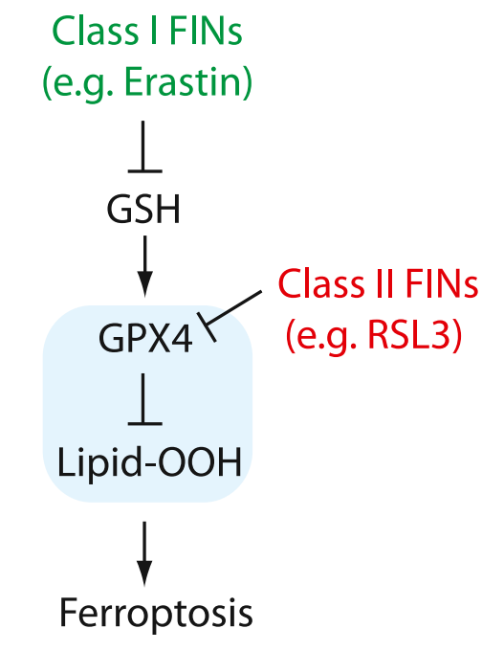
Summary
Ferroptosis overview
Role of GPX4
Direct GPX4 Regulation by RSL3
Indirect GPX4 Regulation by Erastin
RSL3 and PE Animal Treatments
Discovering of additional FINs
FINs: Ferroptosis Inducing Agents
Notes:
To summarize,
Today, we covered several key aspects of ferroptosis and the regulation of the GPX4 enzyme, all of which were studied in this research. We began with an introduction to ferroptosis.
Next, we discussed the critical role of GPX4 in protecting cells from oxidative damage by regulating lipid peroxidation.
Then, we explored how GPX4 is regulated both directly by RSL3 and indirectly by Erastin.
We also examined the effects of RSL3 and Erastin in animal models, focusing on their impact on tumor growth and inhibition.
Finally, we took a brief look at the discovered FINs, highlighting the potential of new compounds to regulate ferroptosis.
That concludes my presentation. Thank you all for your time and attention. If you have any questions about this study, please feel free to ask.

Slide 15
Institute of Cell Biology and Immunology
Thank You!

Slide 16
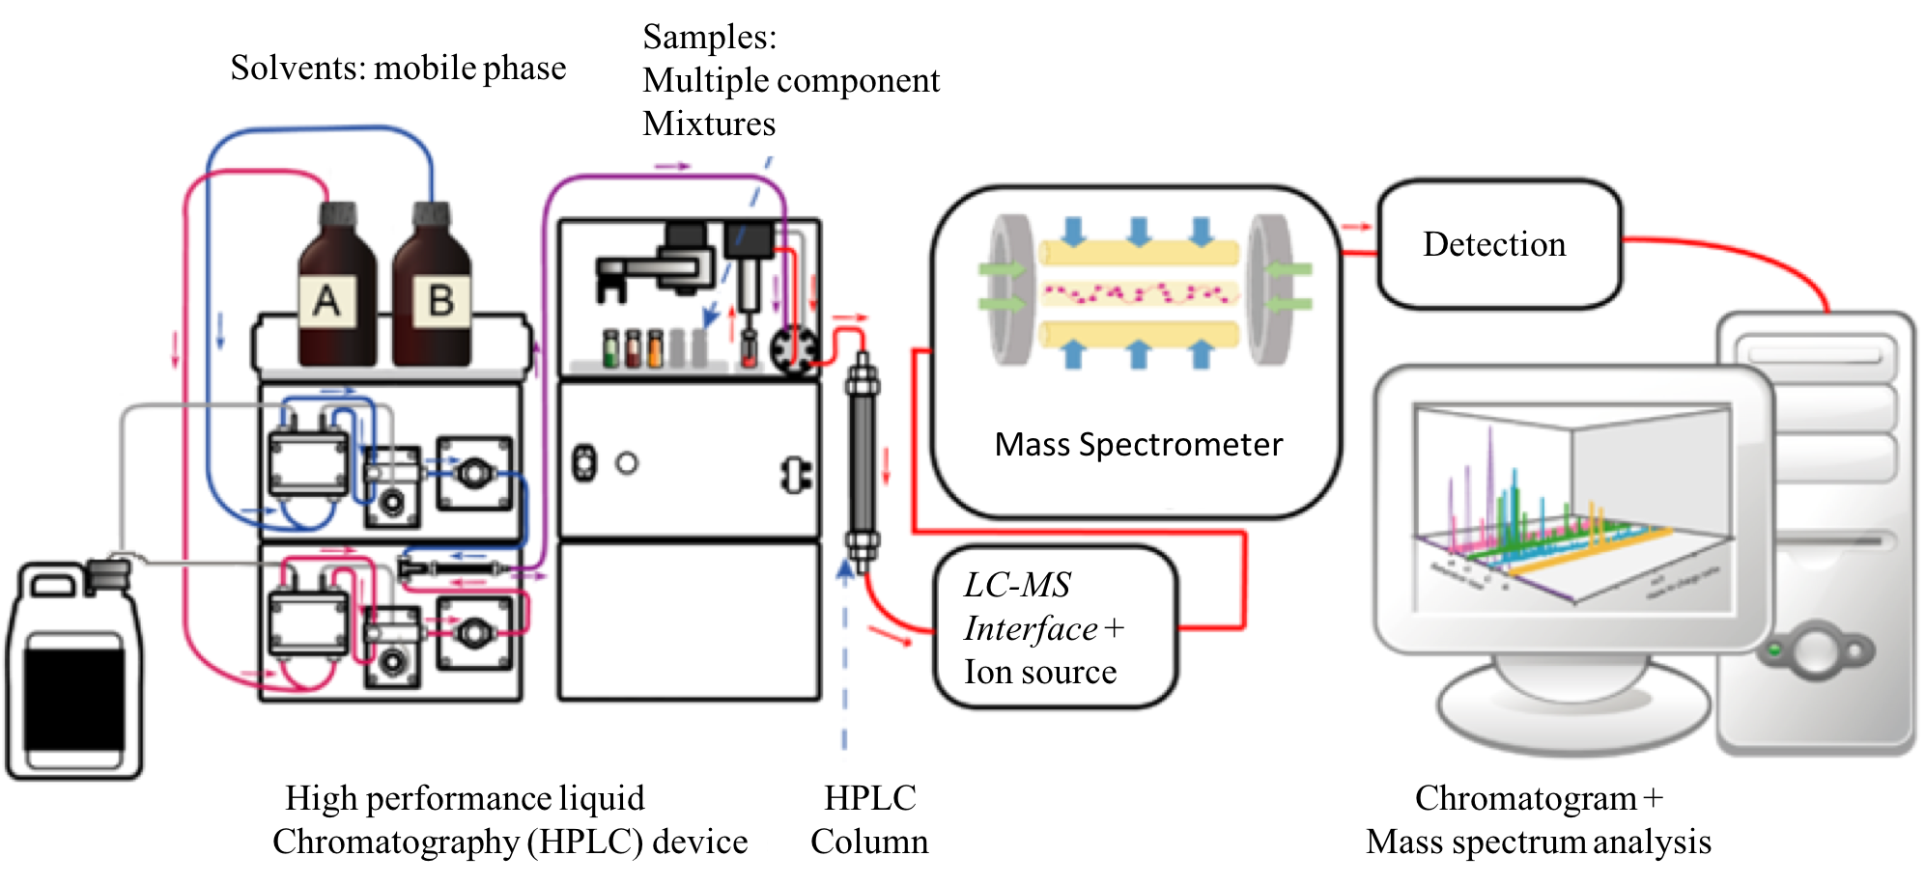

Slide 17
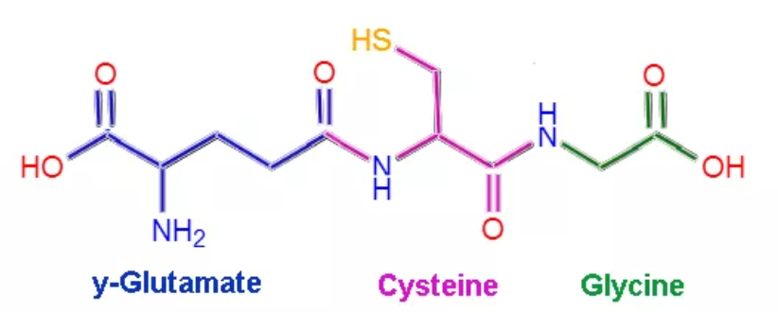
Glutathione Structure

Slide 18
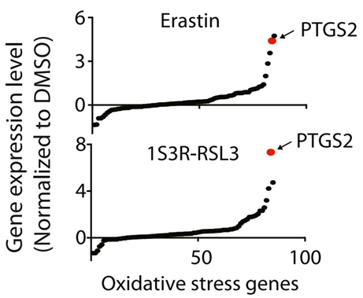
Ferroptosis Inducers Inhibit Tumor Growth in a Xenograft Mouse Model
PTGS2 is the most upregulated gene in BJeLR cells treated with Erastin or RSL3
Indomethacin is used to study PTGS2's role in ferroptosis
Erastin or RSL3-induced ferroptosis isn't affected by indomethacin
PTGS2 upregulation as a downstream marker of ferroptosis
PTGS2 upregulation is a suitable marker for the lipid peroxidation
Figure13: Upregulation of PTGS2 expression upon Erastin and RSL3 treatments

Slide 19
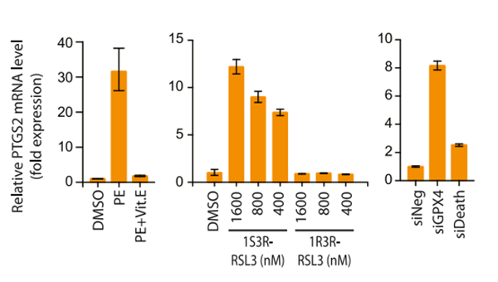
Ferroptosis Inducers Inhibit Tumor Growth in a Xenograft Mouse Model
Piperazine Erastin (PE) is a more water-soluble and more metabolically stable compound
PE upregulated PTGS2 in BJeLR cells
Cotreatment of Vit. E suppressed PTGS2 induction by PE
PTGS2 upregulation is downstream of the lipid peroxidation
Figure14: PTGS2 expression was induced by PE

Slide 20
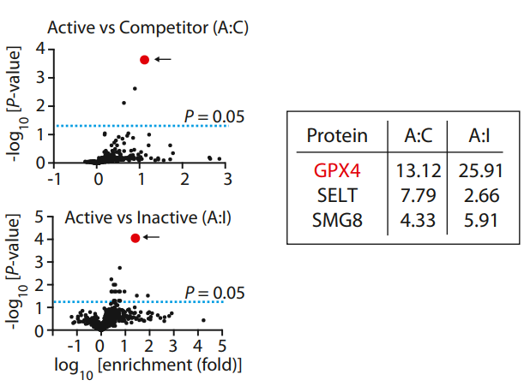
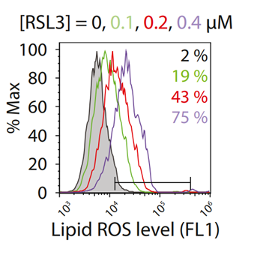
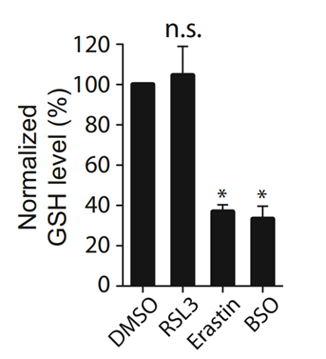
RSL3 Binds to and Inactivates GPX4
.
GPX4 is the top candidate protein target for RSL3
GSH remained unaffected by a lethal RSL3
Increasing RSL3 level leads to increasing in lipid ROS level
Figure6: RSL3 does not deplete GSH.
Notes:
In another part of the study the action-mechanism of RSL3 was studied.

Slide 21
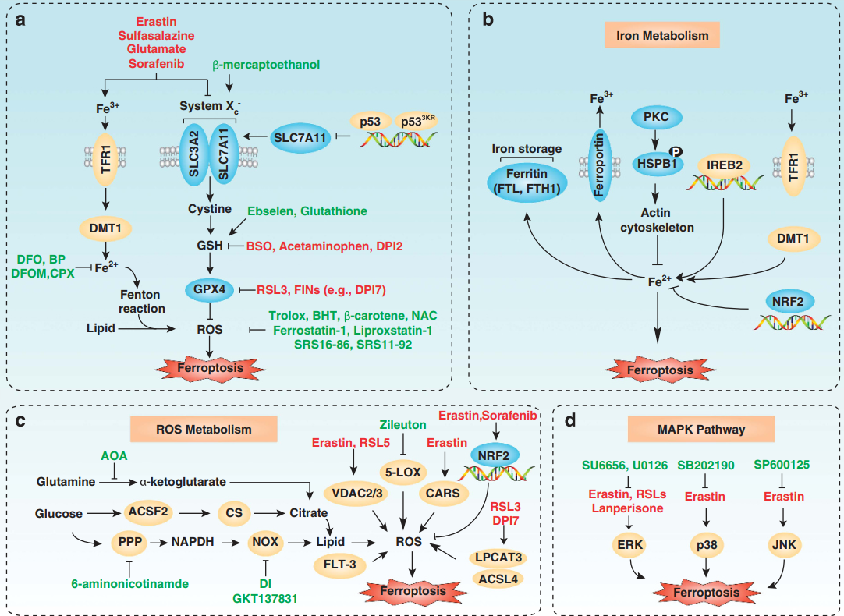
Conclusion
PUFA Oxidation triggers (Yang et al. 2016)
P53, p62-Keap1-NRF2 regulation (L.Jiang et al. 2015, Xie et al. 2017)
ACSL4 and GPX4 regulators (Doll et al. 2017)
Selenium essential (Ingold et al. 2018)
Lipid Metabolism (Yang et al. 2016, Ingold et al. 2018)
FSP1 Pathway suppression (Bersuker, Doll et al. 2019)
Figure17:Molecular mechanisms and signaling pathways of ferroptosis. Xie et al. 2016

Slide 22
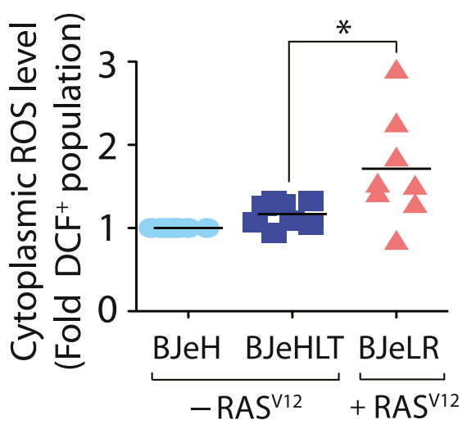
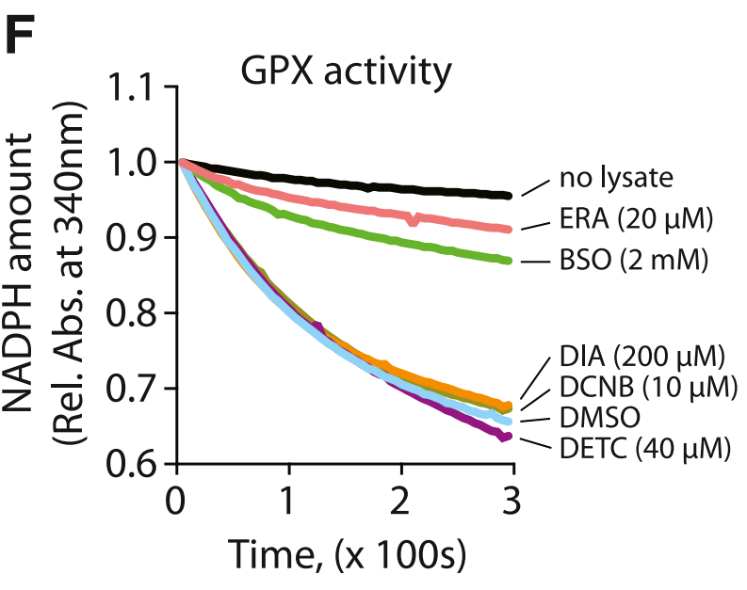
Erastin Induces Ferroptosis via GPX Inactivation
Critical GSH Depletion for Ferroptosis
Cancer Cells Under High Oxidative Stress
Erastin and BSO Induce Selective Ferroptosis
Increased ROS Levels in GSH-Depleted Cells
GSH-Depleting Agents Inactivate GPX Enzymes
Figure5: Basal ROS levels
Figure6: GPX Activity Assay

Slide 23
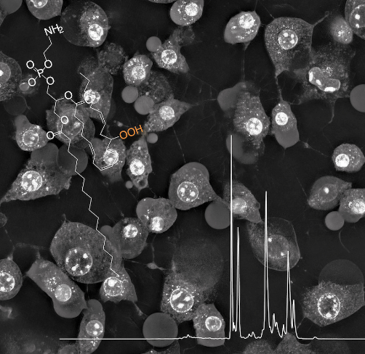
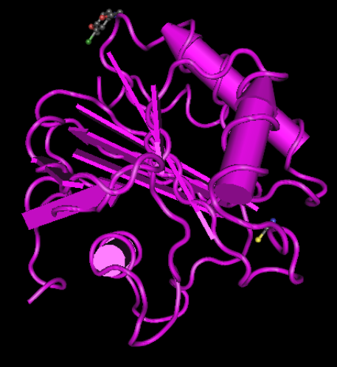
Institute of Cell Biology and Immunology
Regulation of Ferroptotic
Cancer Cell Death by GPX4
Loqman Samani
27.06.2024

Slide 24
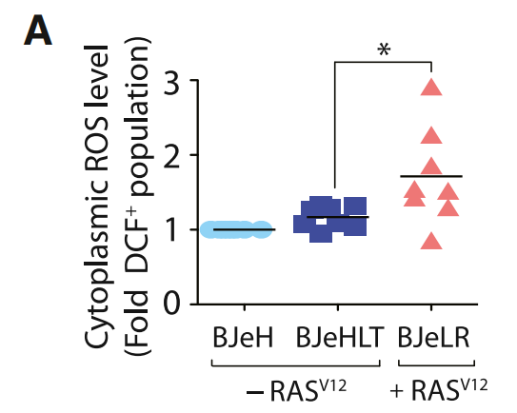
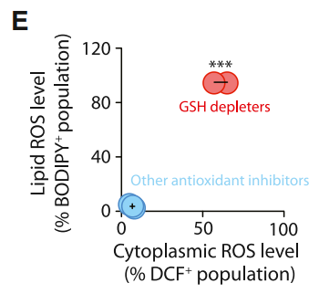
Erastin Depletes Glutathione to Trigger Selective Ferroptosis
most cancer cells are under high levels of oxidative stress
increasing the ROS-scavenging capacity, to prevent oxidative damage
targeting ROS-scavenging systems through multiple points 1) GSH depletion (leading to oxidative cell death)
it is not possible to induce selective ferroptosis in the BJ-derived cell
lines by simply targeting the antioxidant network. Instead,
unique biochemical and metabolic changes downstream of
GSH depletion were likely to be responsible for the selective
induction of ferroptosis.
treated BJeLR cells with either GSH-depleting reagents (erastin or BSO) or other antioxidant-targeting reagents (DETC, DIA, and DCNB)
GSH-depleting reagents strongly increased BODIPY-C11 and H2DCF signals, whereas other antioxidant inhibitors did not increase the fluorescence signals from either ROS sensor, indicating that both cytosolic and lipid ROS levels were increased selectively by GSH depletion in the oncogenic HRAS-containing cell lines
Figure3: Basal ROS levels among BJ-derived cell lines were compared (n = 8)
Figure4: GSH-depleting reagents elevated both cytosolic and lipid ROS level, whereas other antioxidant inhibitors did not (n = 3)

Slide 25
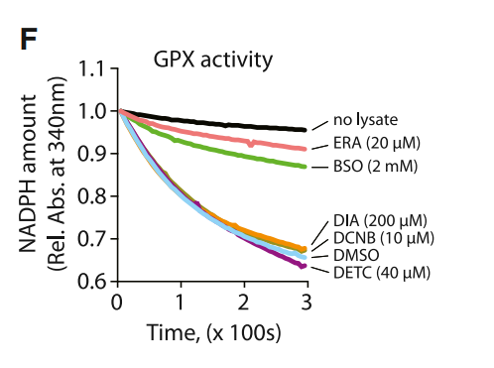
We considered that one consequence of GSH depletion could be inactivation of glutathione-dependent peroxidases (GPXs).
GPXs catalyze the reduction of hydrogen peroxide and organic hydroperoxides to water or the corresponding alcohols, using GSH as an essential cofactor
The total activity of GPXs in BJeLR cells was examined using tert-butylhydroperoxide (tBuOOH) as a substrate, by monitoring the rate of NADPH oxidation, which is coupled to the tBuOOHreducing activity of GPXs in cell lysates
Figure5 inter: these data indicate that erastin and BSO inactivate cellular GPXs, leading to the generation of cytoplasmic and lipid ROS. Other antioxidant inhibitors did not deplete GSH, an essential cofactor for GPX enzyme activity, and therefore, did not inhibit GPX activity and did not cause accumulation of peroxides.
Figure5: GSH-depleting reagents (ERA and BSO) inhibited GPX activity. Rel. Abs., relative absorbance

Slide 26
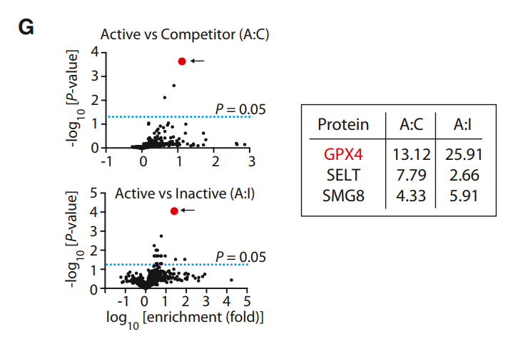
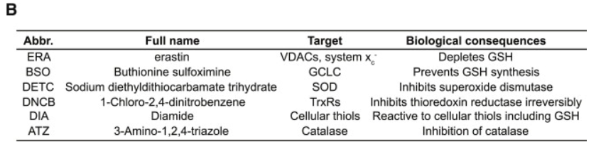
RSL3 Binds to and Inactivates GPX4
Samples for proteomic analysis were prepared by treating intact BJeLR cells with (1S, 3R)-RSL3-fluorescein (active probe treatment), (1R, 3R)-RSL3-fluorescein (inactive probe treatment), or (1S, 3R)-RSL3-fluorescein pretreated with free (1S, 3R)-RSL3 (competitor treatment). Treated cells were lysed, and fluorescein-tagged proteins were affinity purified using Sepharose beads coupled to an anti-fluorescein antibody. Eluted proteins were identified with a Synapt G2 HDMS mass spectrometer (Waters) using a quantitative label-free shotgun proteomic strategy with data-independent scanning (MSE) and ion mobility spectrometry .
This analysis ranked GPX4 (glutathione peroxidase 4, PhGPx) as the top candidate protein target for (1S, 3R)-RSL3.
Figure8: Affinity-based chemoproteomics identified GPX4 (red dot) as the most likely binding protein for (1S, 3R)-RSL3

Slide 27
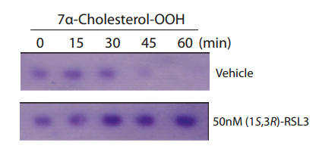
RSL3 Binds to and Inactivates GPX4
In order to examine whether RSL3 binding to GPX4 inactivates the peroxidase activity of GPX4, we treated a clone of the COH-BR1 breast cancer cell line overexpressing GPX4 (L7G4), with (1S, 3R)-RSL3 or vehicle only, prepared cell lysates, and incubated them with 7a-cholesterol hydroperoxide (7a-cholesterolOOH) to determine the rate of reduction to the corresponding alcohol (7a-cholesterol-OH). 7a-cholesterol-OOH is a specific substrate for GPX4; no other GPX enzyme can catalyze the reduction of 7a-cholesterol-OOH.
Figure9: (1S, 3R)-RSL3 inhibits enzyme activity of GPX4

Slide 28
Taken together, these data suggest that GPX4 is a central regulator of ferroptosis induced by erastin and RSL3. Cell death was enhanced in the BJ-derived cell lines expressing HRASV12 due to the increased basal ROS (Figure 2A) and enhanced lipid peroxidation after GPX4 inhibition, which caused selective lethality in this engineered isogenic cell line model.

Slide 29
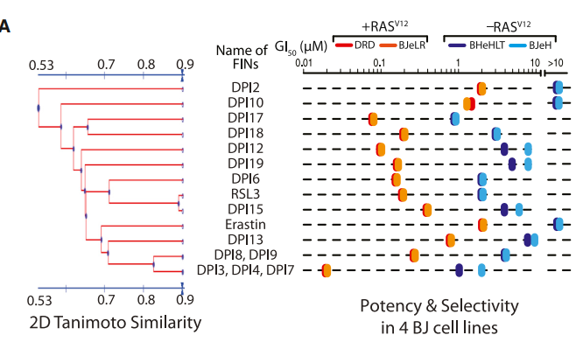
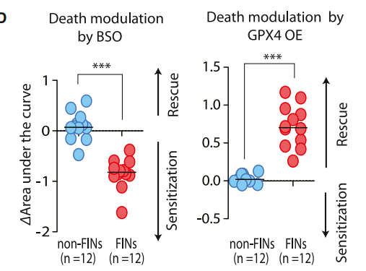
GPX4 Regulates Ferroptosis Induced by 12 Divergent Compounds
In a larger screening campaign to find additional FIN compounds, 14 candidate compounds were discovered out of more than a million tested
BJeLR cells treated with each of the ten additional FIN compounds exhibited an increase in BODIPY-C11 fluorescence, indicating that lipid ROS were generated.
Taken together, these data indicate that compounds that display the RSL phenotype in the four-BJ cell system are ferroptosis inducers. These data also suggest that ferroptotic cell death is not limited to erastin and RSL3 but that a number of additional small molecules can be identified that induce ferroptosis, suggesting that it may be a more generally important mechanism of lethality.
In order to determine the generality of ferroptosis regulation by GPX4, we treated HT-1080 cells with each lethal compound (FIN compound or non-FIN compound) under a GPX4-inhibited condition (using BSO treatment, which depletes glutathione and therefore inhibits all GPXs), or a GPX4-upregulated condition (by overexpressing GPX4). GPX4 inhibition using BSO enhanced ferroptotic cell death induced by all FIN compounds, whereas GPX4 overexpression suppressed ferroptosis induced by all FIN compounds (Figure 5D and Table S3). The modulation effect of BSO and GPX4 overexpression was specific to FIN compounds because their effects on cell death induced by 11 nonFIN compounds were minimal (Figure 5D).
Figure13: Discovery of additional FINs based on selective lethality in the four BJ cell lines
Figure14: Inhibition of GPX4 by BSO sensitized cells to death induced by 12 FIN compounds, whereas activation of GPX4 by cDNA overexpression rescued cells from the lethality of FIN compounds.

Slide 30
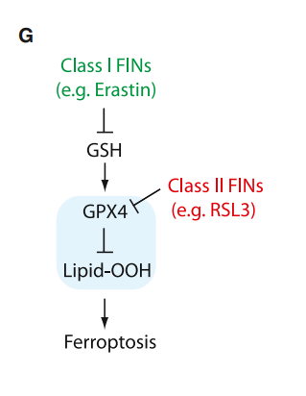
These results demonstrate that GPX4-regulated ferroptosis is a common mechanism shared by multiple independent small molecule scaffolds. All FIN compounds can be categorized into two classes based on the mode of GPX4 inhibition. One class, including erastin, inhibits GPX4 through GSH depletion. The second class inhibits GPX4 without GSH depletion, such as RSL3, which inhibits GPX4 directly
Figure15: Model of GPX4-regulated ferroptosis pathway. Ferroptosis inducers can be categorized into two classes based on the mode of GPX4 inhibition.

Slide 31
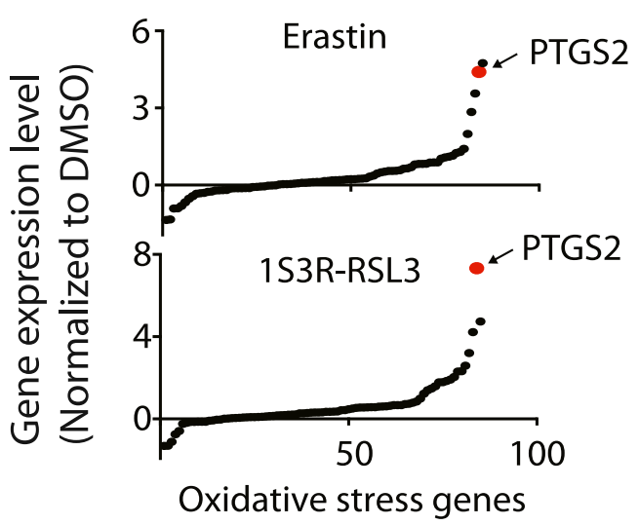
Ferroptosis Inducers Inhibit Tumor Growth in a Xenograft Mouse Model
piperazine erastin(PE), a analog of erastin
PE upregulated PTGS2 in BJeLR cells
PTGS2 upregulation is a suitable marker
for the lipid peroxidation that occurs
during GPX4-regulated ferroptosis
Indomethacin is used to study PTGS2's role in ferroptosis
Erastin or RSL3-induced ferroptosis isn't affected by indomethacin
PTGS2 upregulation as a downstream marker of ferroptosis.
Figure16: Upregulation of PTGS2 expression upon erastin and RSL3 treatments

Slide 32

Ferroptosis Inducers Inhibit Tumor Growth in a Xenograft Mouse Model
developed a more effective analog of erastin that could be tested in vivo. a more water-soluble and more metabolically stable compound .
we named this compound piperazine erastin (PE). PE upregulated PTGS2 in BJeLR cells.
Cotreatment of Vit. E suppressed PTGS2 induction by PE, which indicates that PTGS2 upregulation is downstream of the lipid peroxidation that occurs during ferroptosis (Figure 6B). (1S, 3R)-RSL3, but not (1R, 3R)-RSL3, increased PTGS2 expression (Figure 6B). In addition, knockdown of GPX4 using siRNAs markedly increased PTGS2 mRNA abundance, whereas the effect on PTGS2 mRNA abundance of siDeath was minimal (Figure 6B)
Taken together, these data confirm that PTGS2 upregulation is a suitable marker for the lipid peroxidation that occurs during GPX4-regulated ferroptosis.
Figure17: PTGS2 expression was induced by PE, (1S, 3R)-RSL3, and siGPX4, but not by PE with Vit. E, (1R, 3R)-RSL3, and siDeath

Slide 33
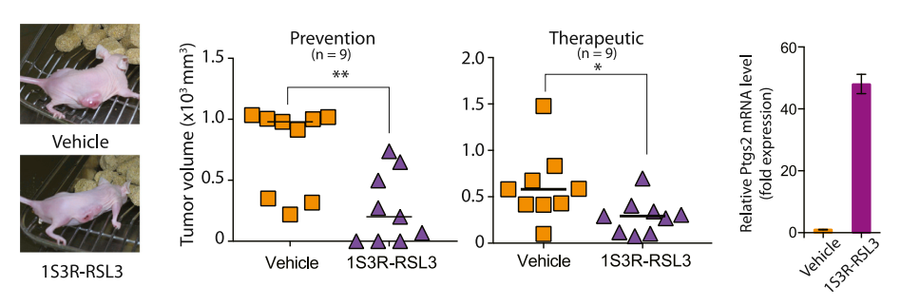
(1S, 3R)-RSL3 could prevent tumor growth
Mice were injected with BJeLR cells s.c. and then with 100 mg/kg (1S, 3R)-RSL3 in the same site 1 day later. The (1S, 3R)-RSL3 injection was repeated twice each week for 2 weeks. Three weeks later, we observed significant prevention of tumor growth in (1S, 3R)-RSL3-treated animals.
Subsequently, we examined the ability of (1S, 3R)-RSL3 to shrink preexisting tumors in a therapeutic study, using s.c. xenograft tumors that had been allowed to grow for 1 week and then treated with 100 mg/kg (1S, 3R)- RSL3 twice a week for 2 weeks. Again, we observed a significant reduction in tumor volume compared with the vehicle-treated control group, with this infrequent dosing
Figure18: (1S, 3R)-RSL3 inhibited tumor formation and tumor progression through induction of ferroptosis as demonstrated by upregulation of PTGS2 in the tumors.

Slide 34
Diffuse Large B Cell Lymphomas and Renal Cell Carcinomas Are Sensitive to Ferroptosis
We investigated whether the mutation status of RAS genes in cancer cells is a predictor of sensitivity to erastin-induced ferroptotic cell death.
The cancer cell line panel contained 38 cancer cell lines with oncogenic-RAS mutations, which allowed us to examine the correlation between RAS mutation status and erastin potency.

